Slide 1
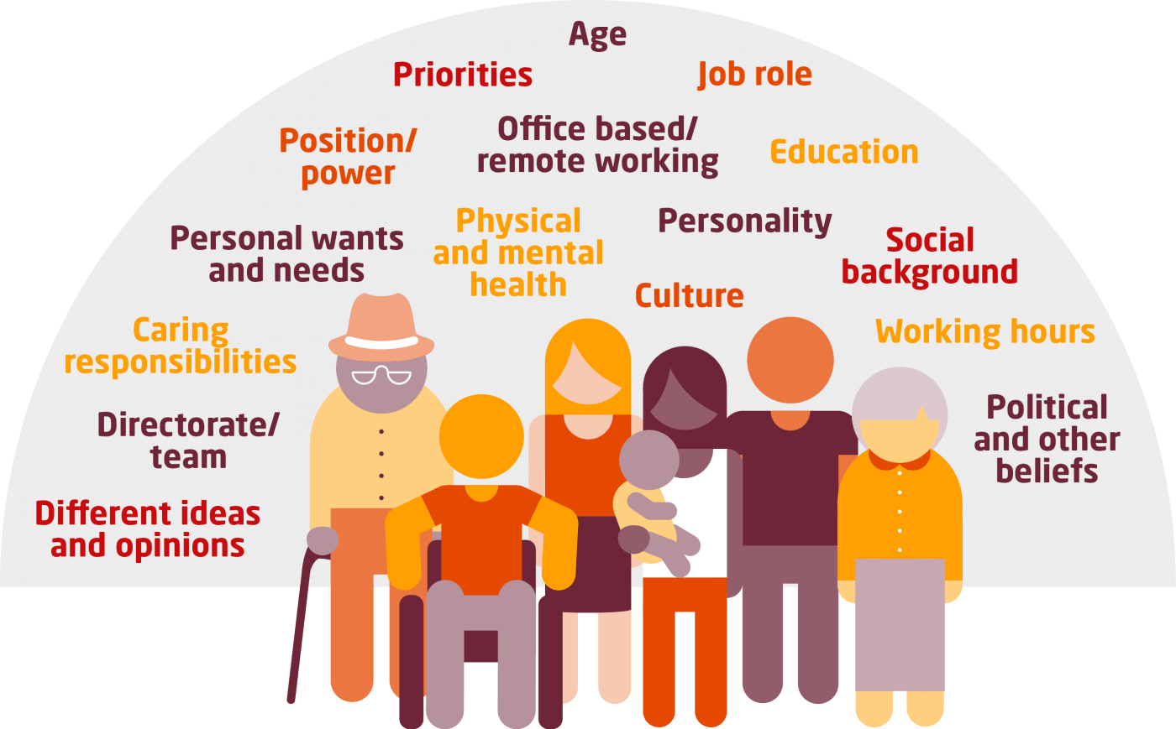
North East and Yorkshire
Inclusion - creating the ideal environment for colleagues to disclose their protected characteristics
Are you interested in creating an environment that is based on openness and transparency?
Would you like to share good learning and practice?
Please join our FREE event on
Thursday, 29th April 2021
9:30am – 12 noon
The workshop will stimulate discussions about the environment that we need to create to get our more diverse staff to disclose.
Open to all Health, Care and VSO colleagues with lived experiences in North East and Yorkshire region.
Sponsored by:
Equality and Inclusion
Workforce and OD Team
North East & Yorkshire Region
NHS England and NHS Improvement
To register for your place, please click here or (https://www.events.england.nhs.uk/events/inclusion-creating-the-ideal-environment-for-colleagues-to-disclose-their-protected-characteristic)
This event will be run on Microsoft Teams and facilitated by
NHS Horizons

